Slide 1
Properties of Traveling Waves
IB Physics | Waves - Sound

Slide 2
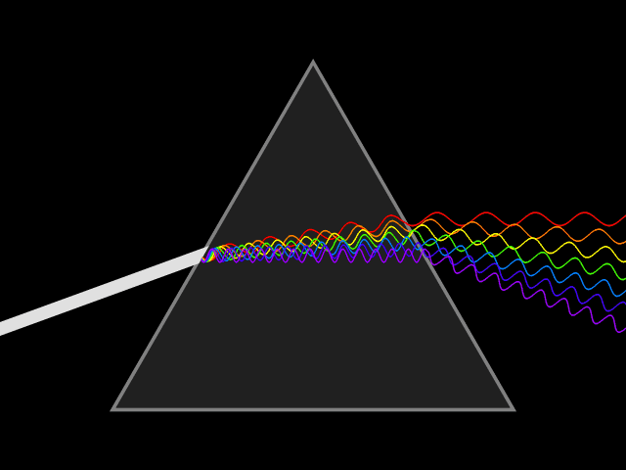
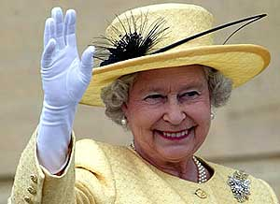
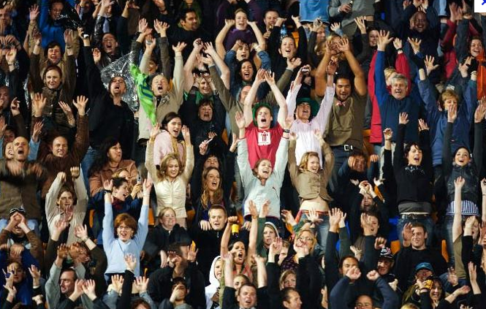
What is a Wave?

Slide 3
What is a Wave?
A wave is a disturbance that carries __________ through matter or space
energy
matter through which a wave travels
medium

Slide 4
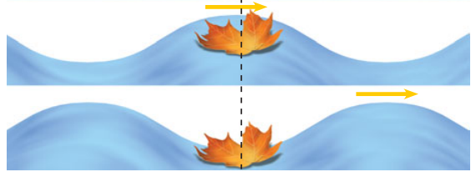
Is the Medium Moving?
The medium particles oscillate back and forth

Slide 5
Two Types of Waves
Particles move perpendicular to the wave’s motion | Particles move parallel to the wave’s motion
Examples: Ripples in a pond Light Waves | Examples: Sound Waves Earthquake Waves
Transverse
Longitudinal

Slide 6
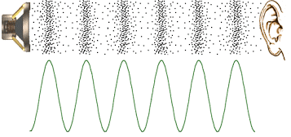
Properties of a Wave
compression
rarefaction
peak/crest
trough

Slide 7
Properties of a Wave
λ
A
λ
distance
A
λ
Property | Symbol | Unit
Amplitude
Wavelength
A
[m]
λ
[m]

Slide 8
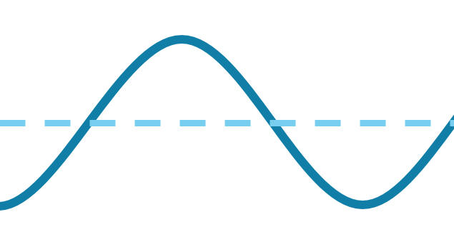
Waves and Energy
↑ Amplitude = ⃝ Energy
↓ Amplitude = ⃝ Energy
↑ Wavelength = ⃝ Energy
↓ Wavelength = ⃝ Energy

Slide 9
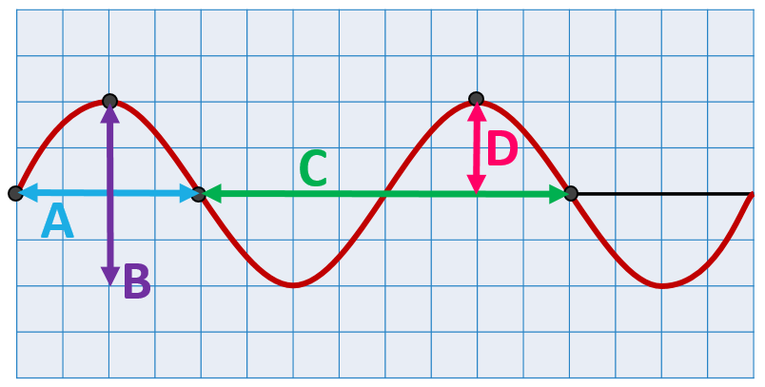
Label this wave
Can you identify the wave properties from this diagram?
Amplitude?
D
Wavelength?
C

Slide 10
How Many Waves?
1.5
0.5
1
0.5
1
1.5

Slide 11
Wavelength is related to frequency
Longer wavelength
_________ frequency
Lower
Shorter wavelength
_________ frequency
Higher

Slide 12
Wave Speed Equation
Speed = Frequency × Wavelength
v
f
λ
= ×
Symbols
= ×
[m s⁻¹]
[Hz]
[m]
Units
[s⁻¹]

Slide 13
IB Physics Data Booklet
*Note: “c” represents the speed of light but the relationship is the same for all wave speeds

Slide 14
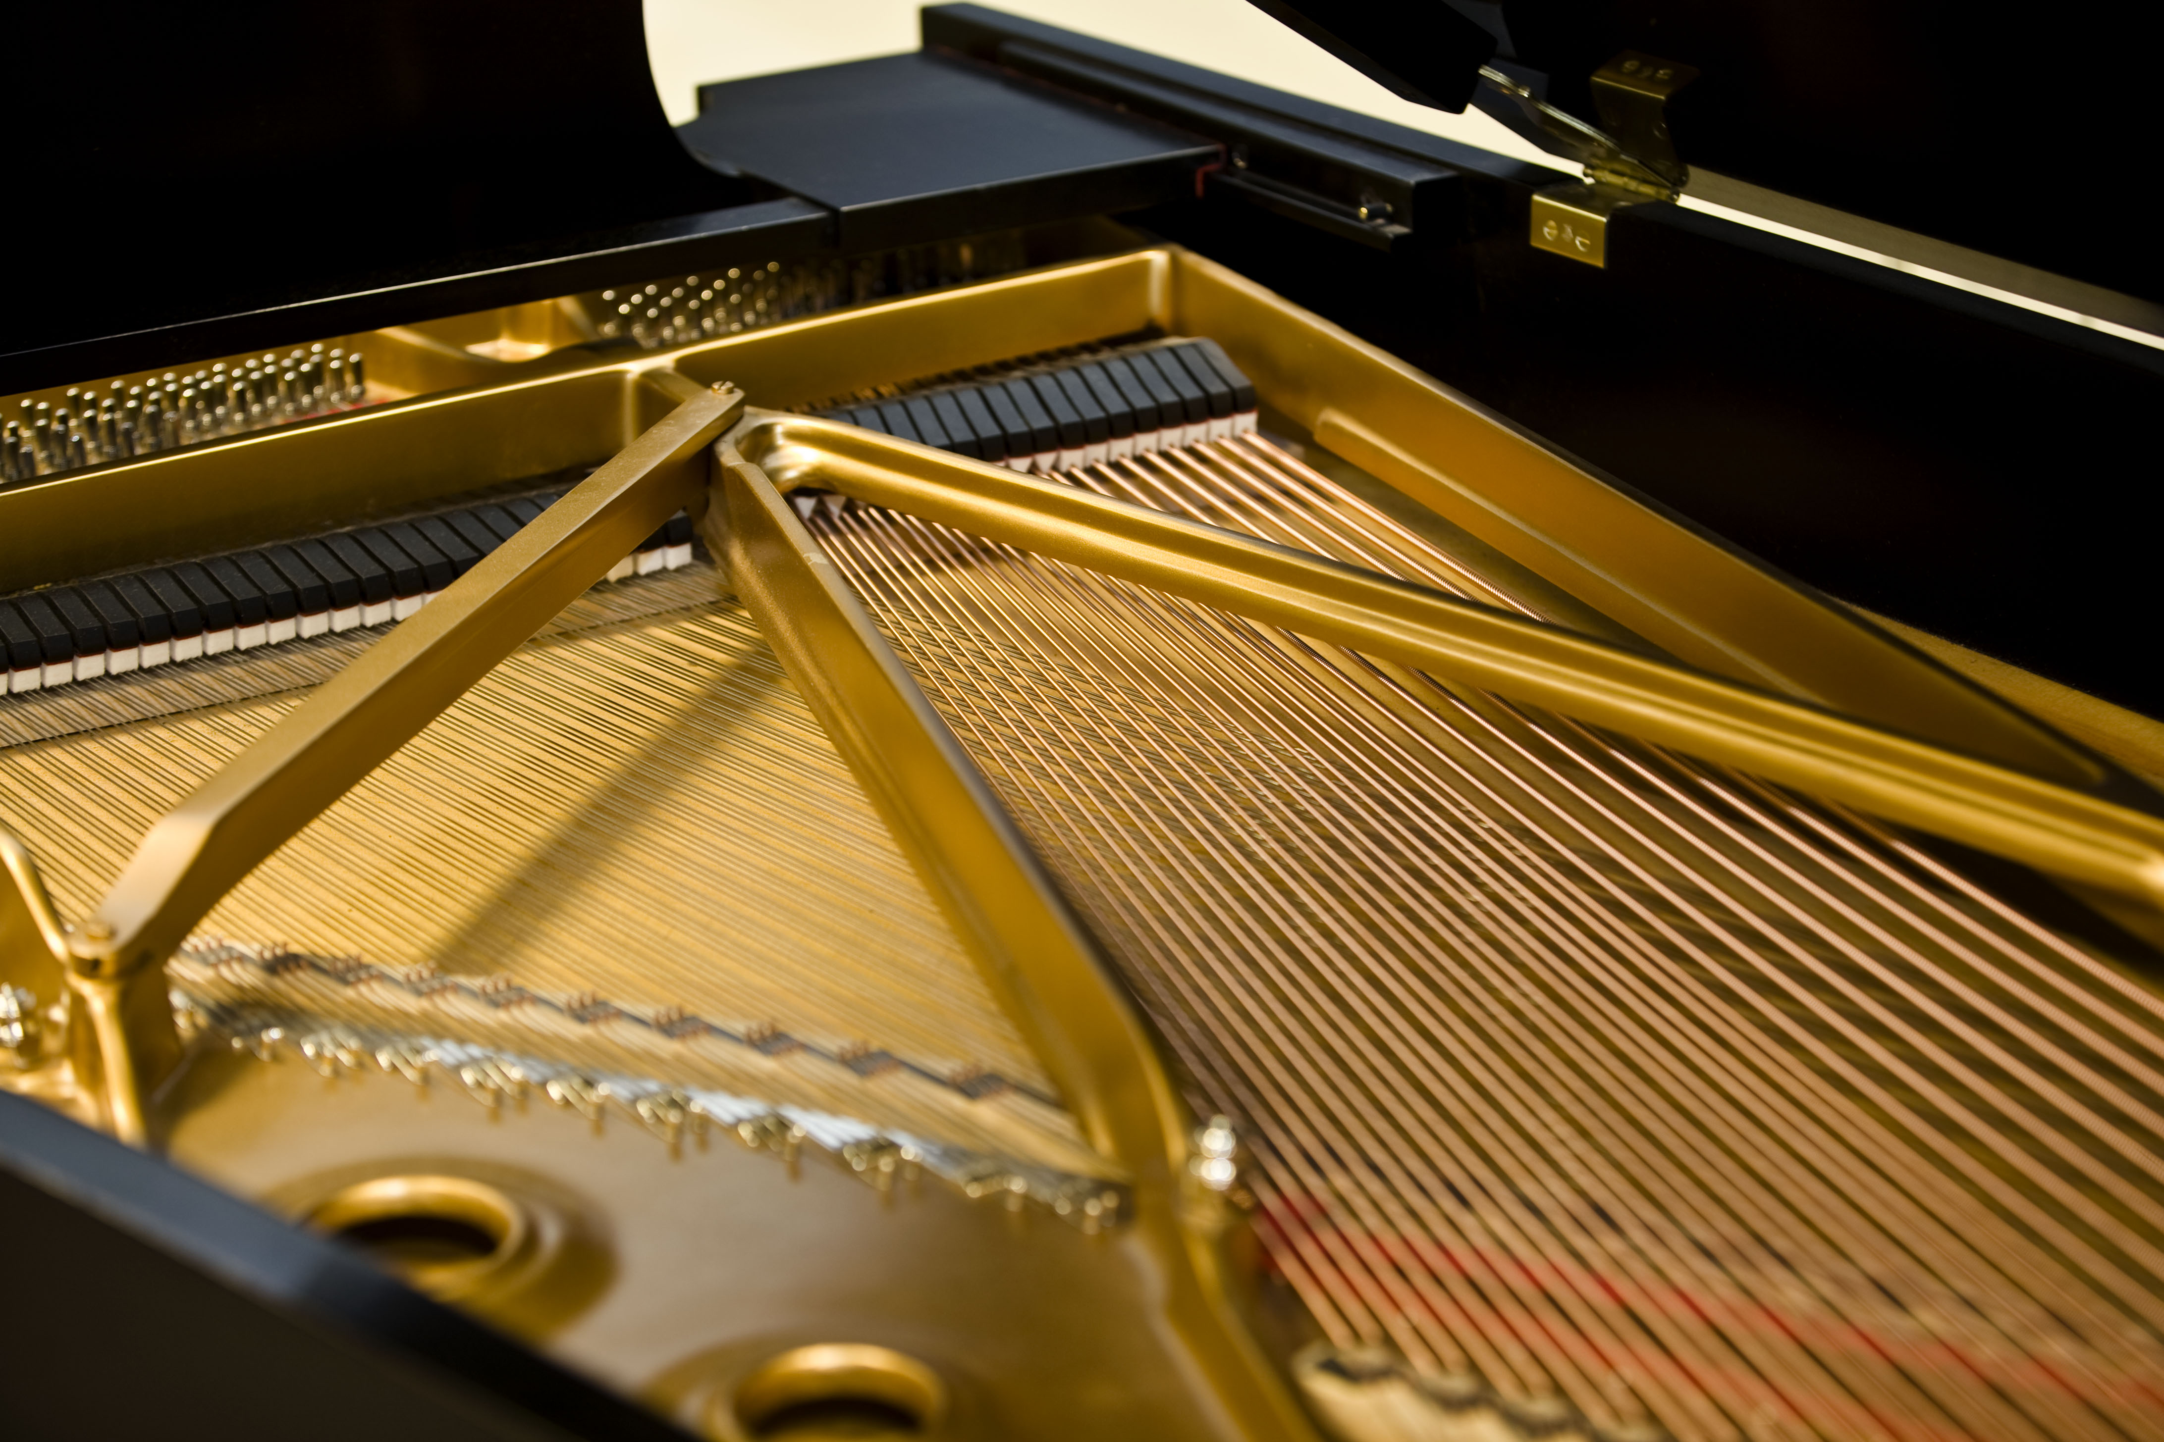
Try this…
A piano string vibrates with a frequency of 262 Hz. If these sound waves have a wavelength in the air of 1.30 m, what is the speed of sound?
$$f=262 Hz$$
$$λ=1.30 m$$
$$v=fλ$$
$$=(262)(1.30)$$
$$=340.6 m/s$$
$$v= ??$$

Slide 15
$$f=\frac{1}{T}$$
$$T=\frac{1}{f}$$
Read a Wave #1
# of Waves
Period
Amplitude
Frequency
3
3
2
1
4 s
Meters
0
1
2 m
2
3
0.25 Hz
0
1
2
3
4
5
6
7
8
9
10
11
12
Seconds

Slide 16
$$f=\frac{1}{T}$$
$$T=\frac{1}{f}$$
Read a Wave #2
# of Waves
Period
Amplitude
Frequency
3
1.5
2
1
8 s
Meters
0
1
3 m
2
3
0.125 Hz
0
1
2
3
4
5
6
7
8
9
10
11
12
Seconds

Slide 17
One Final Question…
The crests of waves passing into a harbor are 2.1 m apart and have an amplitude of 60 cm. 12 waves pass an observer every minute.
What is their frequency? | What is their speed?
$$\frac{12 waves}{1 min}×\frac{1 min}{60 s}$$
$$v=fλ$$
$$=0.2 \frac{waves}{s}$$
$$=(0.2)(2.1)$$
$$f=0.2 Hz$$
$$=0.42 m s^{−1}$$

Slide 18
Lesson Takeaways
I can describe how waves carry energy through a medium
I can compare the properties of transverse and longitudinal waves
I can read a wave’s amplitude, wavelength, period, and frequency from a graph
I can describe the number of complete wavelengths represented in a picture
I can use the wave speed equation to mathematically relate speed, wavelength, and frequency

