Slide 1
Speed of Sound
IB Physics | Waves - Sound

Slide 2
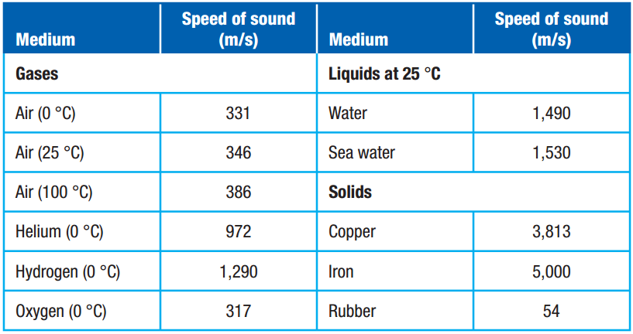
Speed of Sound Depends on Medium
Air (25 °C)
760 mph
0.21 miles/sec
Speed of Sound for Air (at any temp)
v = 331 m s⁻¹ + 0.6 × (Temp in °C)

Slide 3
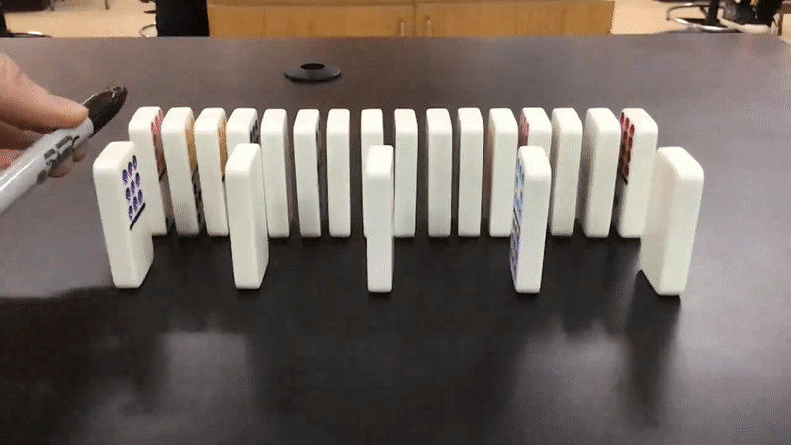
Speed of Sound Depends on Medium
Why does Medium Affect Speed?
molecule spacing
iron
air

Slide 4
Do other factors increase speed?
Frequency?
No
v = f × λ
v = f × λ
v = f × λ
Amplitude?
No
*Independent from all other wave properties

Slide 5
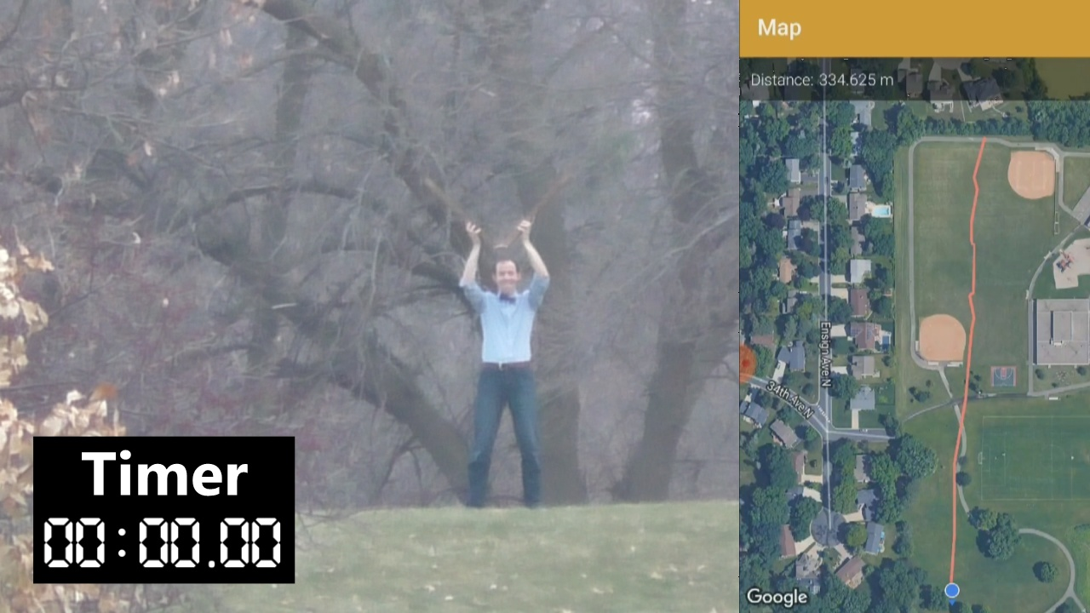
Sound is fast, but not THAT fast…
$$d=335 m$$
$$t=0.935 s$$
$$v=\frac{d}{t}$$
$$=\frac{335 m}{0.935 s}$$
$$=358 m s^{−1}$$

Slide 6
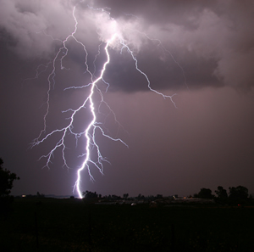
Using the Speed of Sound
You see lightning strike and immediately start counting, once you get to 7 seconds, you hear the boom of thunder. How far away is the storm?
Air (25 °C)
346 m/s
760 mph
0.21 miles/sec
$$d=vt$$
$$=\left(0.21\right)\left(7\right)$$
$$=1.47 miles$$

Slide 7
Shortcut for Clocking a Storm
As soon as you see lightning strike, start counting…
One one thousand, Two one thousand…
Stop counting as soon as you hear the thunder from that bolt of lightning
Distance in Miles = Time / 5

Slide 8
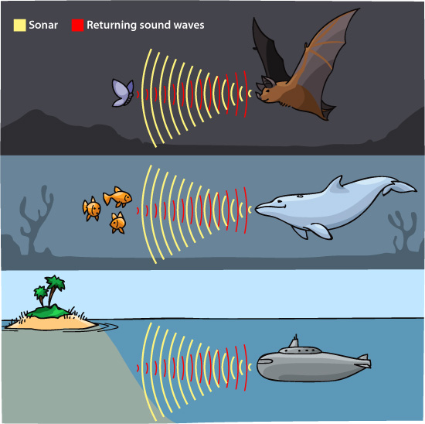
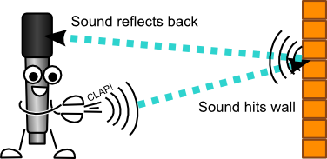
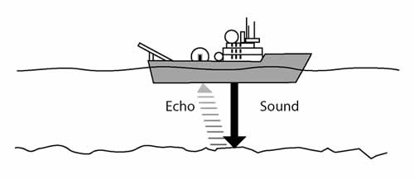
ECHO…. Echo…. Echo….
When you hear an echo, you are hearing the sound after it has reflected off of an object and returned to your ear

Slide 9
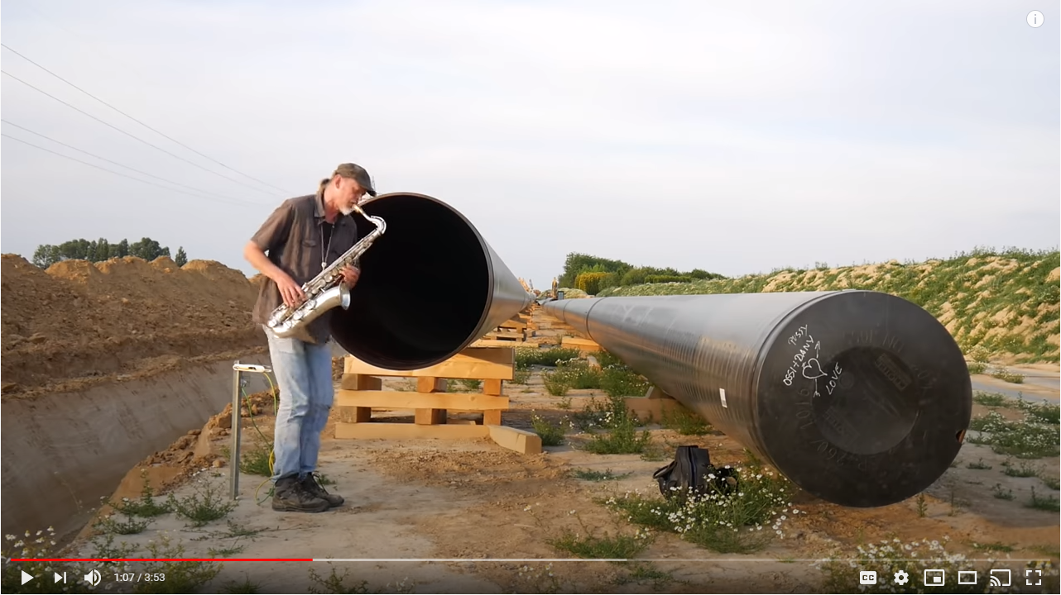
Calculating Distance from an Echo
A saxophonist plays a duet with himself using the echo of the sound in a long pipe. If the speed of sound is 340 m/s and echo returns 1.3 seconds after the original sound, how long is the pipe?
$$v=\frac{d}{t}$$
Only half the time to go one way
$$d=vt$$
$$=\left(340\right)\left(0.65\right)$$
$$=221 m$$

Slide 10
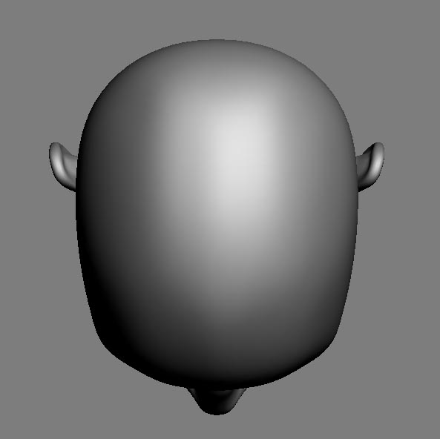
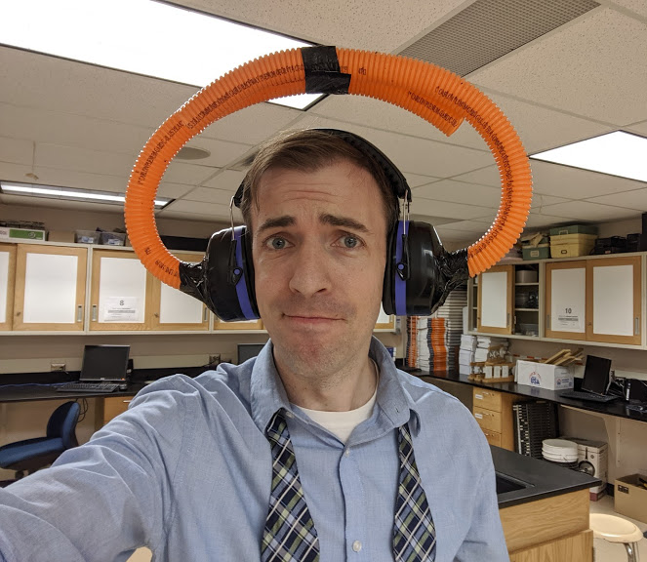
How do we locate sounds?
Sound reaches one ear before the other. It also sounds different from different locations due to the shape of our ears.
source

Slide 11
Lesson Takeaways
I can describe why sound travels at different speeds in different media
I can calculate how far a distant object is by timing an echo

