Slide 1
Snell’s Law & Critical Angle
IB Physics | Waves - Light

Slide 2
Remember the Bend
faster
n = 1
n = 1.33
slower

Slide 3
Remember the Bend
slower
n = 1.33
n = 1
faster

Slide 4
Snell’s Law
$$\frac{n_{1}}{n_{2}}=\frac{sinθ_{2}}{sinθ_{1}}$$
θ₁
n₁
n₂
θ₂

Slide 5
IB Physics Data Booklet
$$\frac{n_{1}}{n_{2}}$$
$$=\frac{v_{2}}{v_{1}}$$
$$\frac{n_{1}}{n_{2}}=\frac{sinθ_{2}}{sinθ_{1}}=\frac{v_{2}}{v_{1}}$$
$$\frac{n_{1}}{n_{2}}=\frac{sinθ_{2}}{sinθ_{1}}$$

Slide 6
Using Snell’s Law
While aiming at a marble at the bottom of a fish tank filled with water (n₂ = 1.33), you point so that you can measure the angle of your incident rays. What is the angle of refraction?
80°
n₁ = 1
n₂ = 1.33
$$\frac{n_{1}}{n_{2}}=\frac{sinθ_{2}}{sinθ_{1}}=\frac{v_{2}}{v_{1}}$$
$$\frac{n_{1}}{n_{2}}=\frac{sinθ_{2}}{sinθ_{1}}$$
θ₂
$$θ_{2}=\sin^{−1}\left(\frac{n_{1}sinθ_{1}}{n_{2}}\right)$$
Where does it “appear” the marble is?
$θ_{2}$ $=\sin^{−1}\left(\frac{1sin⁡(80°)}{1.33}\right)$
$$=47.8°$$

Slide 7
Try this…
If the light travels from air to diamond (n = 2.42) at an angle of incidence of 34°, find the angle of refraction.
$$\frac{n_{1}}{n_{2}}=\frac{sinθ_{2}}{sinθ_{1}}$$
$$θ_{2}=\sin^{−1}\left(\frac{n_{1}sinθ_{1}}{n_{2}}\right)$$
$$\frac{n_{1}}{n_{2}}=\frac{sinθ_{2}}{sinθ_{1}}=\frac{v_{2}}{v_{1}}$$
34°
n₁ = 1
n₂ = 2.42
$θ_{2}$ $=\sin^{−1}\left(\frac{1sin⁡(34°)}{1.33}\right)$
$$=13.4°$$
θ₂

Slide 8
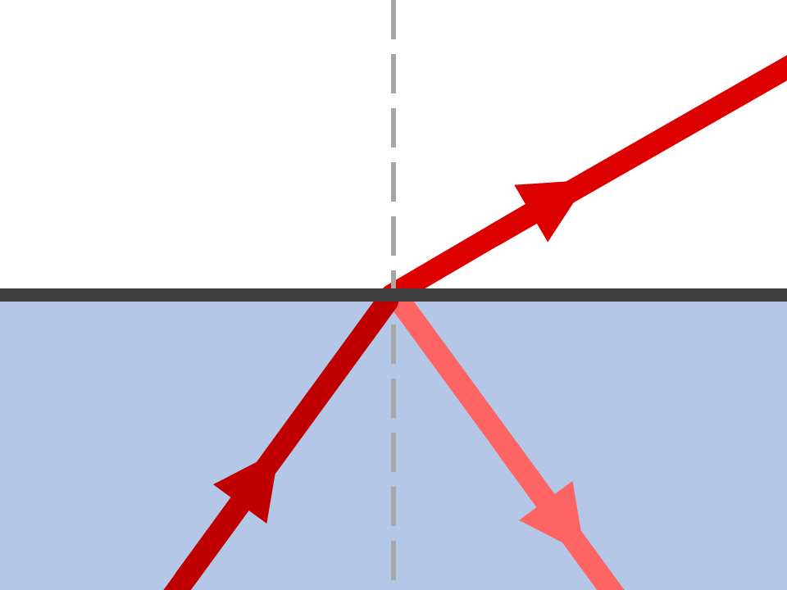
Refraction AND Reflection

Slide 9
Critical Angle
θ_{c}
Critical Angle:
Angle at which θ₂ = 90° so no light escapes
n₂ = 1
θ₂ = 90°
n₁ = 1.33
θ_{c}
Beyond the critical angle → total internal reflection

Slide 10
Remember the Bend
faster
n = 1
n = 1.33
slower

Slide 11
Critical Angle
$$\frac{n_{1}}{n_{2}}=\frac{sinθ_{2}}{sinθ_{1}}$$
$$θ_{1}=\sin^{−1}\left(\frac{n_{2}sinθ_{2}}{n_{1}}\right)$$
$$θ_{c}=\sin^{−1}\left(\frac{n_{2}sin⁡(90°)}{n_{1}}\right)$$
$$=\sin^{−1}\left(\frac{n_{2}}{n_{1}}\right)$$
n₂ = 1
θ₂ = 90°
n₁ = 1.33
θ_{c}
Note: this only happens when transitioning from more dense to less dense

Slide 12
Try This
What’s the critical angle between glass and air?
$$\frac{1.52}{1}=\frac{sin⁡(90°)}{sinθ_{c}}$$
$$\frac{n_{1}}{n_{2}}=\frac{sinθ_{2}}{sinθ_{1}}$$
$$θ_{c}=\sin^{−1}\left(\frac{1}{1.52}\right)$$
$$=41.1°$$
n₂ = 1
θ₂ = 90°
n₁ = 1.52
θ_{c}

Slide 13
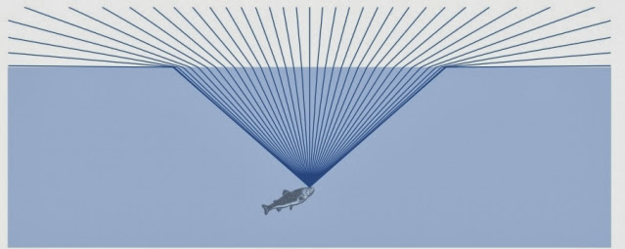
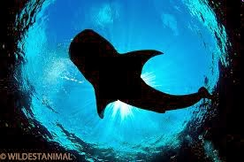
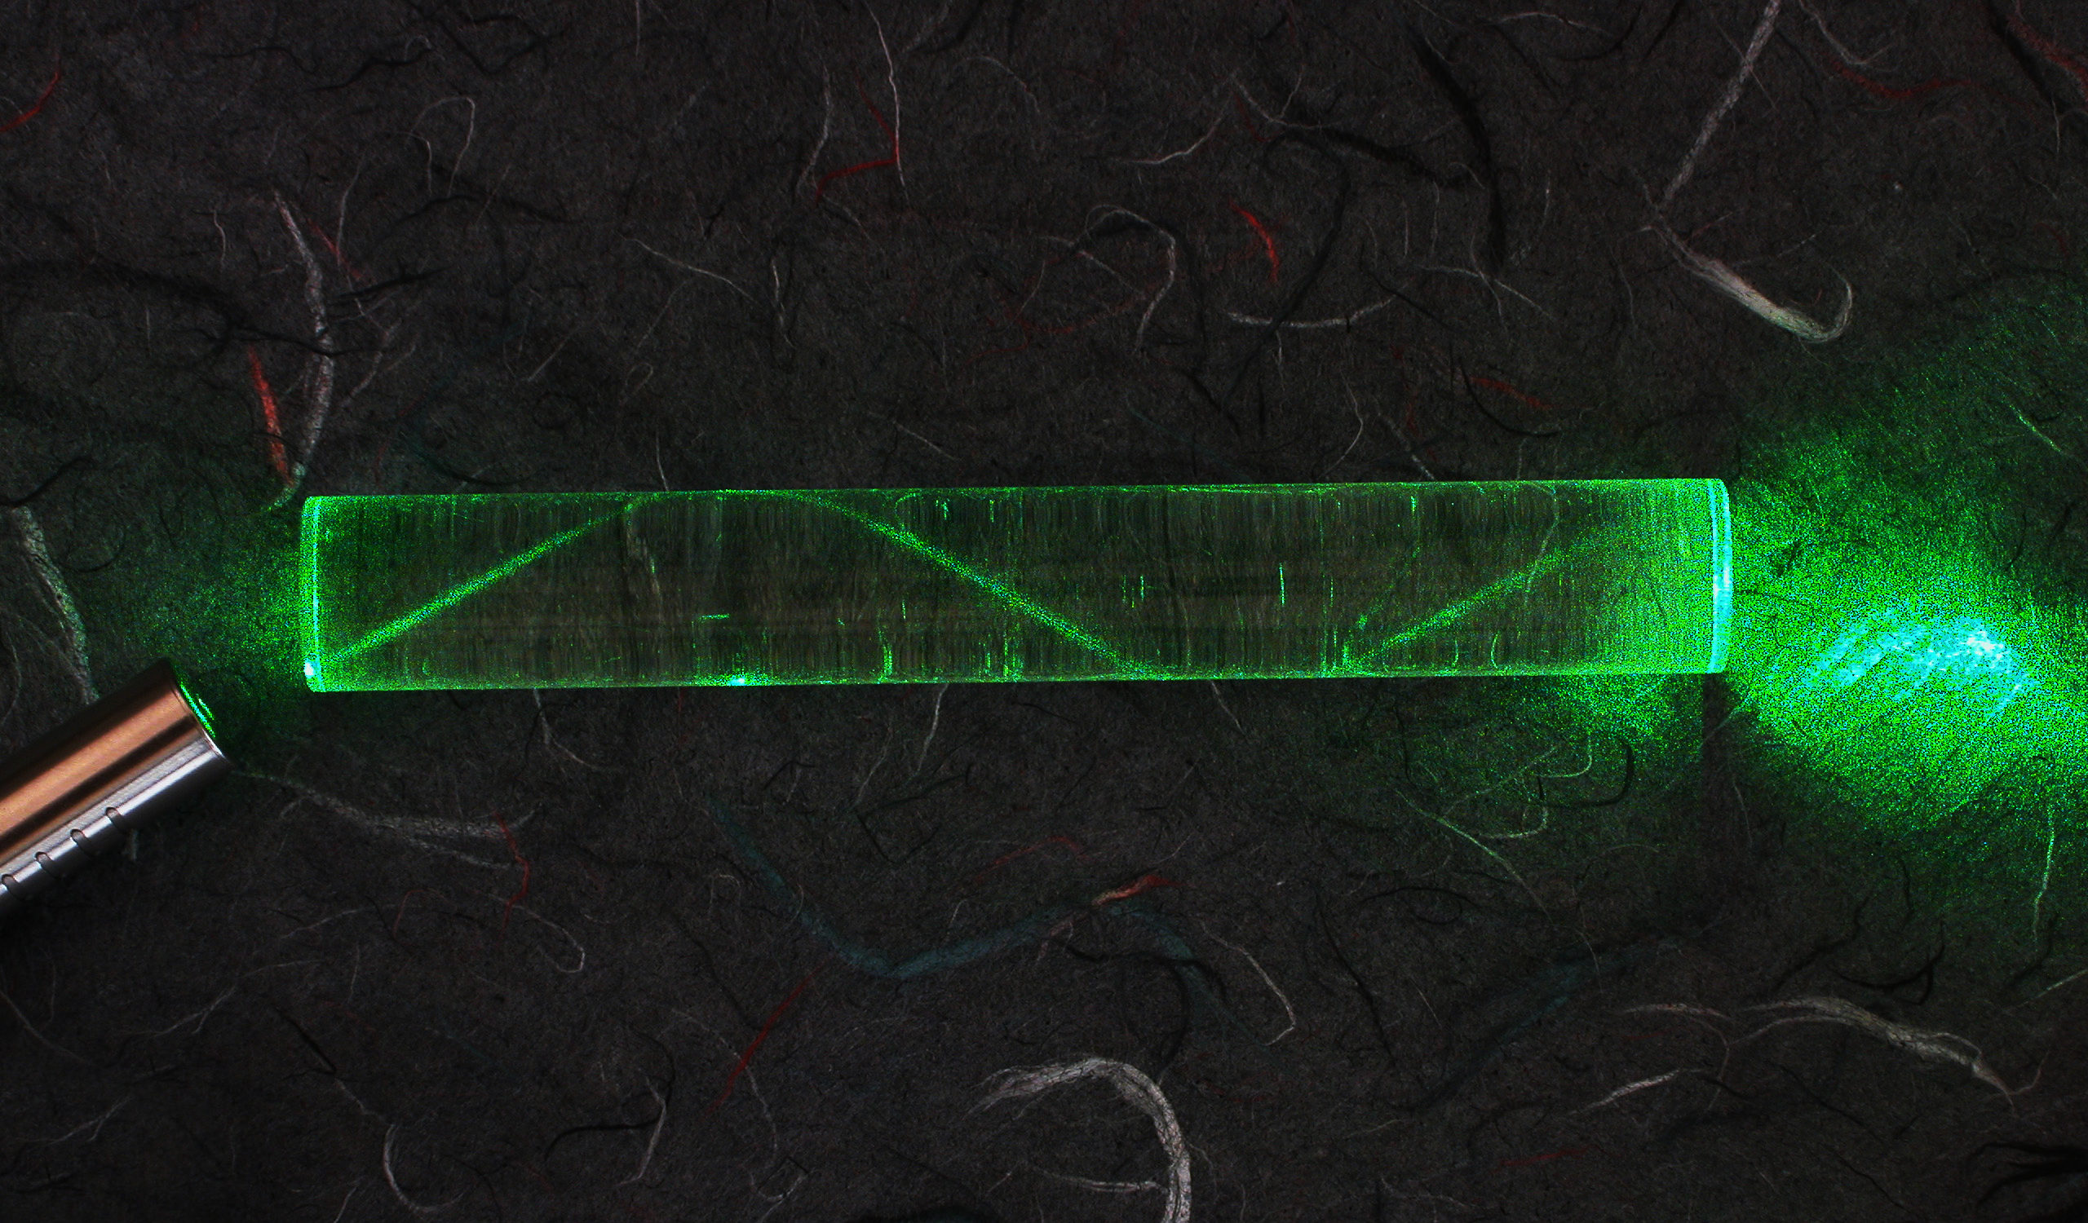
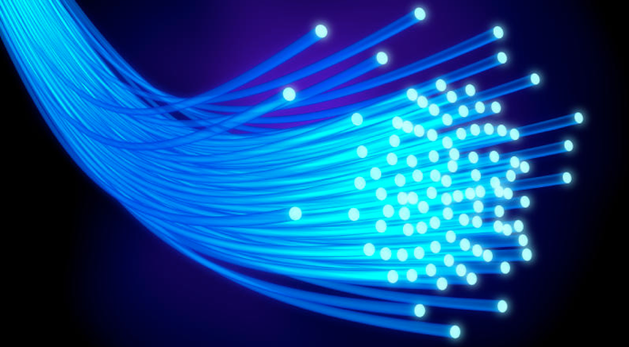
Why does it matter?
Total Internal Reflection
Snell’s Circle
Fiber Optic Cables for transmitting information with light

Slide 14
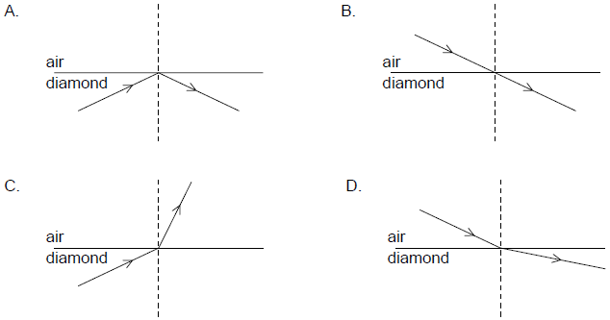
Sample IB Question
A light ray is incident on an air–diamond boundary. The refractive index of diamond is greater than 1. Which diagram shows the correct path of the light ray?

Slide 15
Lesson Takeaways
I can mathematically relate the angles of refraction to the indices of refraction for the materials
I can describe the phenomenon of total internal reflection
I can calculate the critical angle of incidence so that the light cannot escape the medium

